Slide 1
Spring Core
Java Web Application Development
Muhammad Touhidul Islam Senior Software Engineer BJIT Limited

Slide 2
Groovy
Object Oriented Programming Language
Optionally typed
Both programming and scripting Language
Native regex and lots of functional supports
Java platform based
Can be used Java libraries
More meaningful code and a lot more…

Slide 3
Groovy: Setup
Download and Install Groovy
Download: https://groovy.apache.org
Set GROOVY_HOME path in environment variables
Open terminal and check version
#groovy -version
Groovy shell
#groovysh
Or include binary:
Maven: <dependency>
<groupId>org.codehaus.groovy</groupId>
<artifactId>groovy-all</artifactId>
<version>3.0.5</version>
<type>pom</type>
</dependency>
Gradle: implementation 'org.codehaus.groovy:groovy-all:3.0.5'

Slide 4
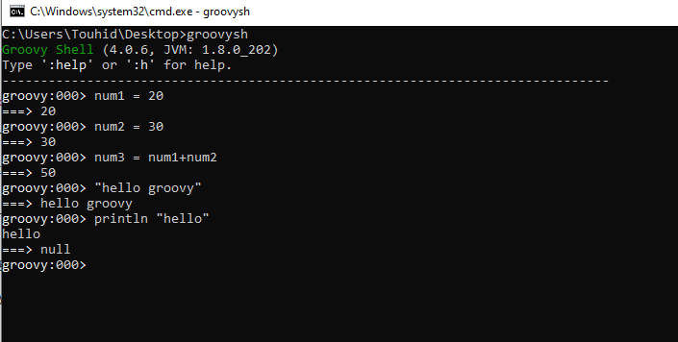
Groovy: Run Code
Groovy Shell

Slide 5
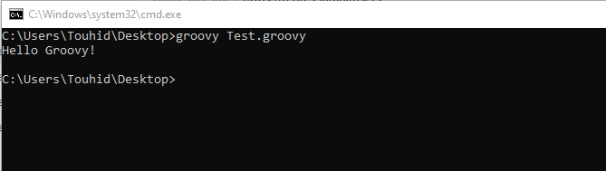
Groovy: Run Code
Using Command Prompt
# groovy ClassName.groovy
class Test { static void main(String[] args) { println("Hello Groovy!") } }
Save as: Test.groovy

Slide 6
Groovy: Run Code
IDE: IntelliJ IDEA
Link: https://www.jetbrains.com/idea/download
class Test { static void main(String[] args) { println("Hello Groovy!") } }
Groovy automatically imports the packages –
groovy.lang.*, groovy.util.*, java.lang.*, java.util.*,
java.net.* and java.io.*

Slide 7
Groovy: Basic Syntax
Comments
Semicolons
Optional
Identifiers
Start with a letter, a dollar or an underscore. Cannot start with a number.
Variable can be defined by native syntax for the data type or using the def keyword
class Test { static void main(String[] args) { // This program prints ‘Hello Groovy!’ println("Hello Groovy!") /* This is an example of groovy identifier. Quoted function identifier.*/ "say hello"() } static void "say hello"() { def identifierName = "Quoted function identifier" println "Hello from - " + identifierName } }

Slide 8
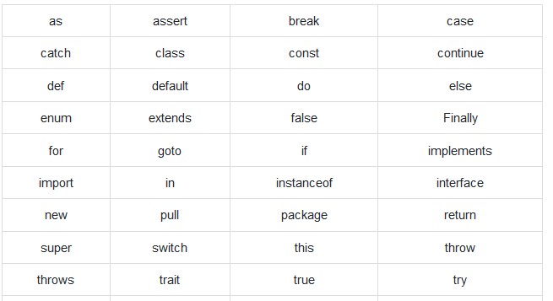
Groovy: Basic Syntax
Keywords

Slide 9
Groovy: Data Type
Optional type, type safe
If not specified, assumed to be java.lang.Object
Built-in type: short, byte, int, long, float, double, char, Boolean, String
class Test { static void main(String[] args) { int x = 5; long y = 100L; float a = 10.56f; double b = 10.5e40; BigInteger bi = 30g; BigDecimal bd = 3.5g; println(x); println(y); println(a); println(b); println(bi); println(bd); } }
class Test { static void main(String[] args) { def x = 5; def name = “Groovy"; println(x); println(name); } }

Slide 10
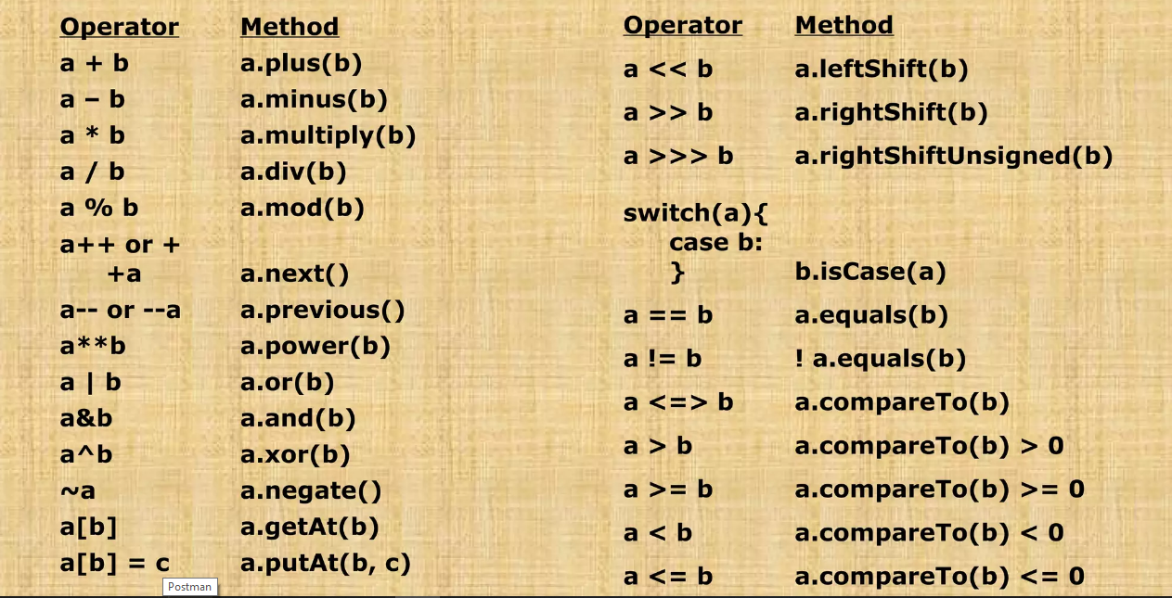
Groovy: Operators
Arithmetic operators, Relational operators, Logical operators, Bitwise operators and Assignment operators

Slide 11
Groovy: Decision Making
int num1 = 0 int num2 = 1 switch (num1) { case 0: switch (num2) { case 0: println("num1 is 0, num2 is 0") break case 1: println("num1 is 0, num2 is 1") break default: println("nested default case!!") } break case 1: println("num1 is 1!") break default: println("No matching case found!!"); }
if, else/if, nested if, switch and nested switch statements
switch(expression) { case expression #1: statement #1 ... case expression #2: statement #2 ... case expression #N: statement #N ... default: statement #Default ...
if(condition) { statement #1 ... } else{ statement #2 }
int a = 2
if (a<100) { println(“Value is less than 100"); }

Slide 12

Groovy: Loops
while, for, for-in loop
while(condition) { statement #1 statement #2 ... }
for(variable declaration;expression;Increment) { statement #1 statement #2 … }
int[] array = [0,1,2,3]; for(int num in array) { println(num); }
Loop control statements
break
continue
Closure
listOrMap.each { key, value -> doSomething.. } listOrMap.eachWithIndex { it, index -> doSomething }

Slide 13
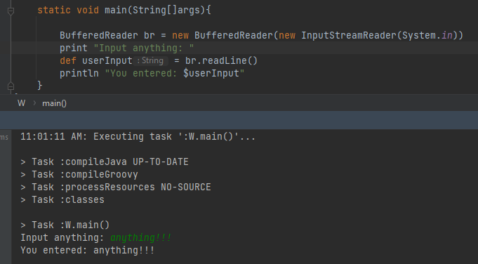
Groovy: Console Input
Using InputStreamReader() and BufferedReader.

Slide 14
Groovy: Useful links
https://groovy-lang.org/syntax.html
https://www.tutorialspoint.com/groovy/index.htm
https://www.baeldung.com/groovy-language
https://www.javatpoint.com/groovy

Slide 15
Assignment
Practice syntax and operators.
Implement leap year checker.
Implement evaluation system.
Val >= 8 Excellent.
Val >= 6.5 and <8 Very Good.
Val >=5 and <6.5 Good.
Val >= 3.5 and <5 Below average.
Val < 3.5 Poor.

Slide 16
Thank You

